Slide 1
尼諾思科技股份有限公司 報告人：teuton
BPF CO-RE
(Compile Once - Runs Everywhere) 簡報
Notes:
Fast Packet Processing with eBPF and XDP Concepts, Code, Challenges, and Applications

Slide 2
INTRODUCTION
eBPF SYSTEM
eBPF CO-RE
compilable PLATFORMS
TOOLS
eBPF PROGRAMS
Example

Slide 3
INTRODUCTION

Slide 4
extended Berkeley Packet Filter
technology with origins in the Linux kernel. Used as:
Network Performence
Firewall
Security
Tracing
Device Driver
Notes:
‹#›

Slide 5
eBPF SYSTEM

Slide 6
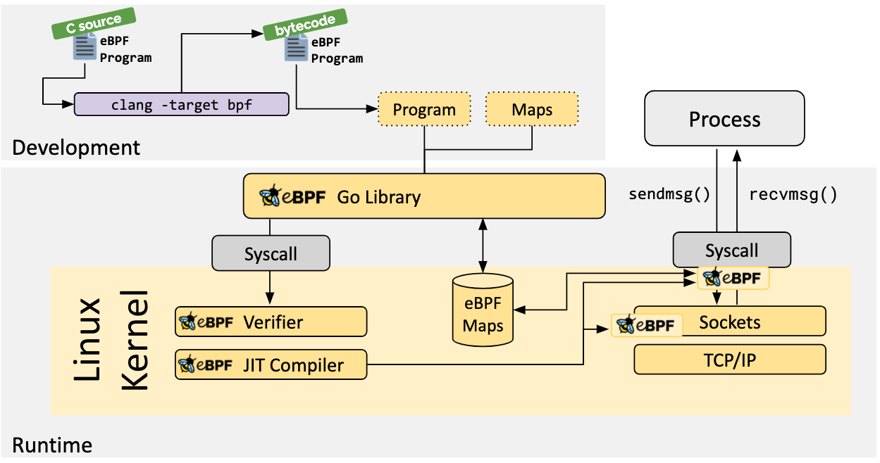
eBPF structure

Slide 7
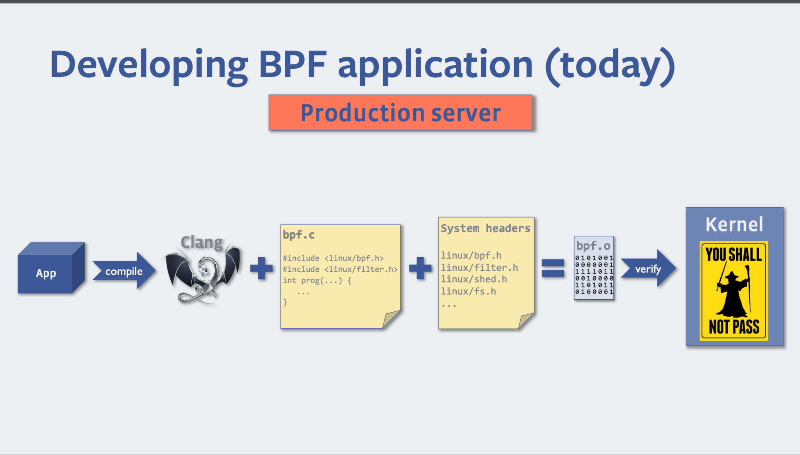
deploy an eBPF program

Slide 8
BPF CO-RE

Slide 9
Issues with eBPF
heavy resource utilization (clang/LLVM)
compile in target takes serious memory and time
dependency on kernel headers package
every target is different. Need to re-compile on each target
testing and development iteration is quite painful
error only shows up at run time, need to test on EVERY kernel
Notes:
‹#›

Slide 10
BPF CO-RE component
BTF (BPF Type Format) information in 5.5+ kernel
Reduce size and solve kernel header problem
Compiler (clang)
provide BPF program relocation information in kernel
bpftool (kernel or github)
generate headers and make tests easier
BPF loader (libbpf)
dynamic load BPF program into kernel
advanced BPF features (kernel)
Notes:
‹#›

Slide 11
BPF CO-RE program
compilable PLATFORMS

Slide 12
Major linux distribution with BTF
Fedora 31+
RHEL 8.2+
OpenSUSE Tumbleweed (in the next release, as of 2020-06-04)
Arch Linux (from kernel 5.7.1.arch1-1)
Manjaro (from kernel 5.4 if compiled after 2021-06-18)
Ubuntu 20.10
Debian 11 (amd64/arm64)

Slide 13
Clang/LLVM 10+ packaged by default
Fedora 32+
Ubuntu 20.04+
Arch Linux
Ubuntu 20.10 (LLVM 11)
Debian 11 (LLVM 11)
Alpine 3.13+

Slide 14
TOOLS

Slide 15
Bpftool
Generate vmlinux.h
Rarely has to be regenerated. Unless it’s another architecture
Generate BPF skeleton with BPF binary
Show information about BPF program
Run BPF program in the kernel testing infrastructure for BPF
...

Slide 16
Clang
Compile bpf.c to BPF binary
GCC may support BPF program compilation in the future
Compile .o to ELF binary
add BTF relocations to describe what kernel data various parts of the program are trying to access

Slide 17
libbpf
userspace loaders
bpf_helpers.h: BPF kernel helper functions (BPF program)
bpf.h: defines various userspace bpf helpers for working with BPF programs and maps (userspace)
libbpf.h: includes libbpf types and functions (userspace)
define pre-existing observability technologies
kernel tracepoints
kprobes
user tracepoints
uprobes

Slide 18
eBPF PROGRAMS

Slide 19
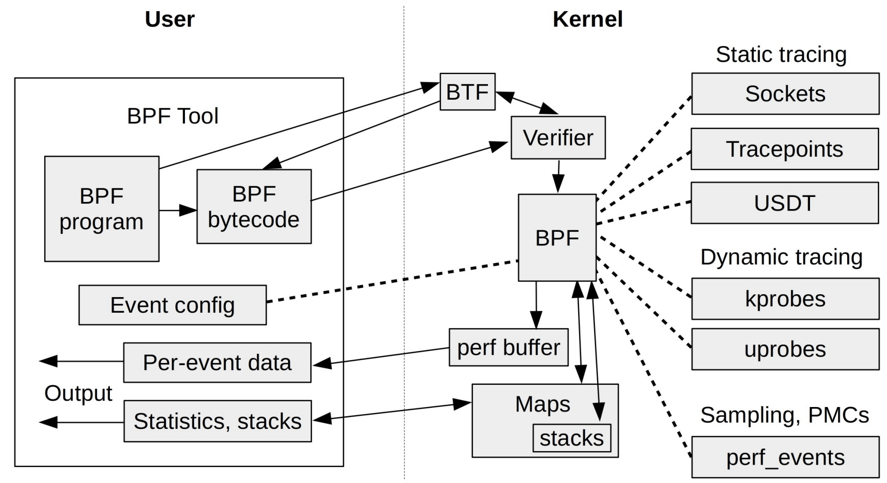
Basic program structure

Slide 20
Maps
Communication between BPF loader and BPF program
Data structure that can be shared and accessed by multiple BPF programs
hash maps
arrays
event-based structures
Handled through file descriptors in userspace programs (bpf_map__fd())
struct {...} execs SEC(“.maps”): map definition (.bpf.c)

Slide 21
Example
BPF CO-RE

Slide 22
How to compile BPF CO-RE?
/sys/kernel/btf/vmlinux --(bpftool)--> vmlinux.h
.bpf.c + vmlinux.h --(clang)--> .bpf.o
.bpf.o --(bpftool)--> .skel.h
.c + .skel.h + libbpf --(clang)--> ELF file
Notes:
‹#›

Slide 23
BPF skeleton
Help load the BPF program and work with its maps
functions
data structures
Generated structure that describes the program that will be loaded

Slide 24
BPF app life cycle
Auto-generated in .skel.h:
Open phase <-> obj = <name>__open()
Load phase <-> <name>__load(obj)
Attachment phase <-> <name>__attach(obj)
Tear down phase <-> <name>__destroy(obj)
Notes:
‹#›

Slide 25
Example
User and kernel space interaction

Slide 26
BPF program (.bpf.c): define attach point and action
#include "vmlinux.h"
#include <bpf/bpf_helpers.h>
SEC("tracepoint/syscalls/sys_enter_execve")
int tracepoint__syscalls__sys_enter_execve(struct trace_event_raw_sys_enter *ctx) { … return 0; }
Notes:
‹#›

Slide 27
userspace (.c): BPF program memory setting
int err = 0;
struct rlimit rlim = {
.rlim_cur = 512UL << 20, /* 512 MBs */
.rlim_max = 512UL << 20,
};
err = setrlimit(RLIMIT_MEMLOCK, &rlim);
if (err) /* handle memory error */
Notes:
‹#›

Slide 28
userspace (.c): BPF app cycle
struct hello_bpf *obj;
obj = hello_bpf__open();
err = hello_bpf__load(obj);
err = hello_bpf__attach(obj);
read_trace_pipe(); /* user-defined function
let userspace interact with kernel attach point */
hello_bpf__destroy(obj);
Notes:
‹#›

